Slide 1
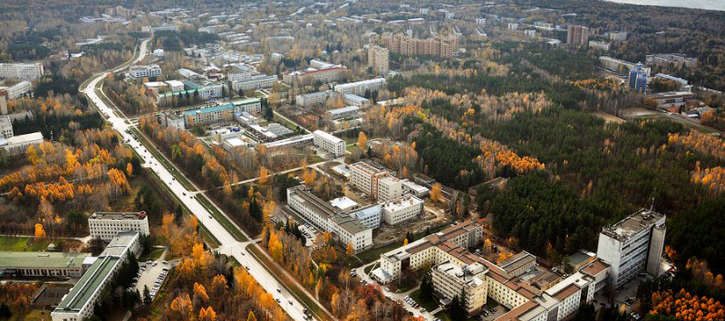

SoftLab-NSK Solutions
Mikhail Shadrin

Slide 2

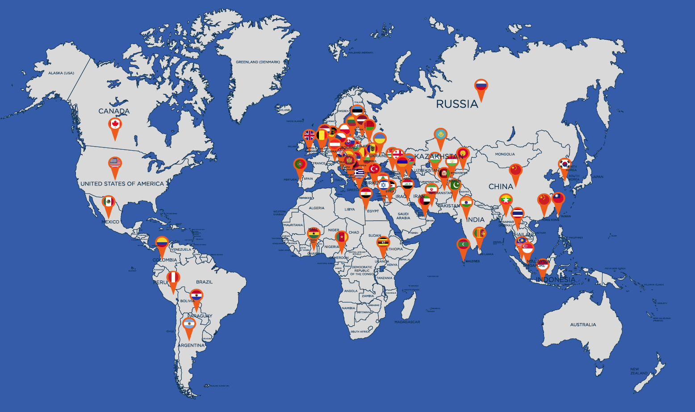
SoftLab-NSK: Success story
More than 30 years on TV market.
Our solutions are used by more than a thousand broadcasters
in 65 countries around the world.
More then 50 dealers cooperate with us in many countries, including China, Indonesia, Hong Kong, India, Hungary, Czech Republic, Romania, Malaysia, Thailand, Vietnam, etc.
Notes:
I am representing SoftLab-NSK company which is located in Novosibirsk, Russia. It was founded in 1991 and now is one of the leading companies developing hardware and software for multimedia and TV broadcasting in the Russian and former USSR markets. Last years many companies from different parts of the world are becoming our customers. The products are reliable, extendable and reasonable priced.
The target group are local broadcasters with the following tasks – commercials and local news insertion and computer graphics overlay. And the general idea is All that should be done at one point, in one card.

Slide 3
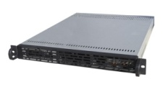
SoftLab-NSK Solutions
TV company
SCTE-35
SCTE-35
SCTE-104
(SDI)
ForwardT
Channel-in-a-Box
Forward Encoder
Forward
Splicer

Slide 4
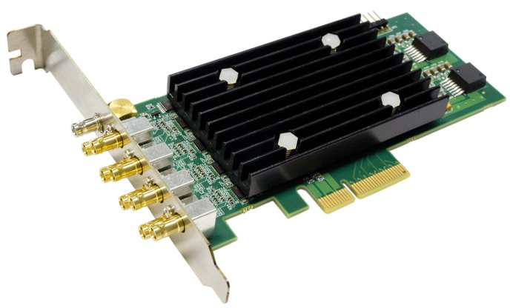
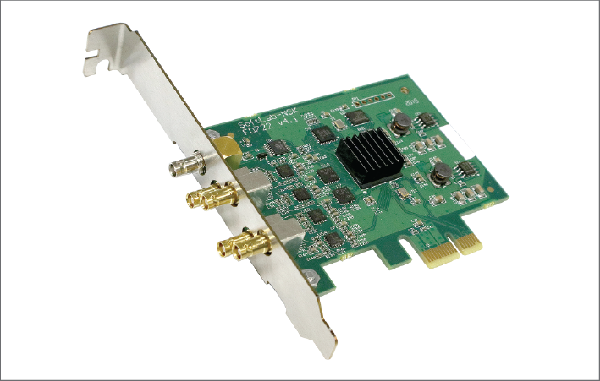
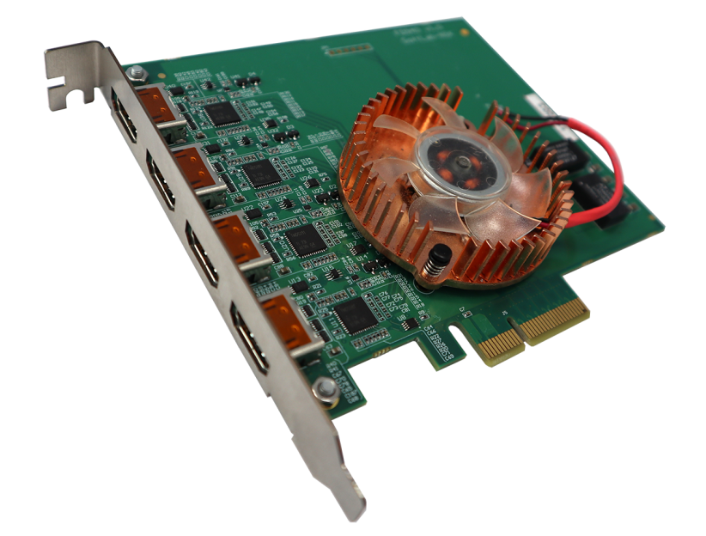
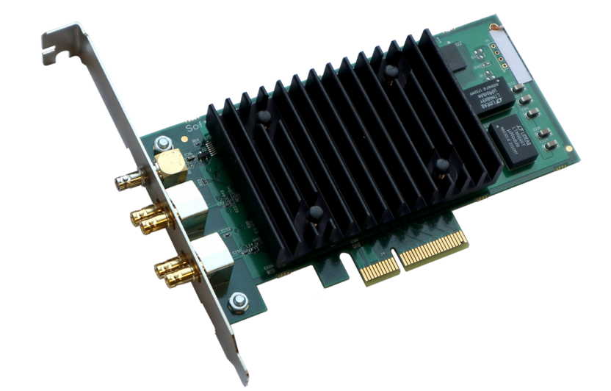


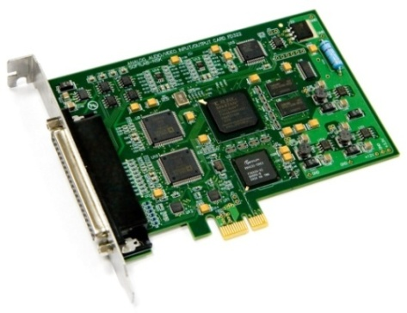
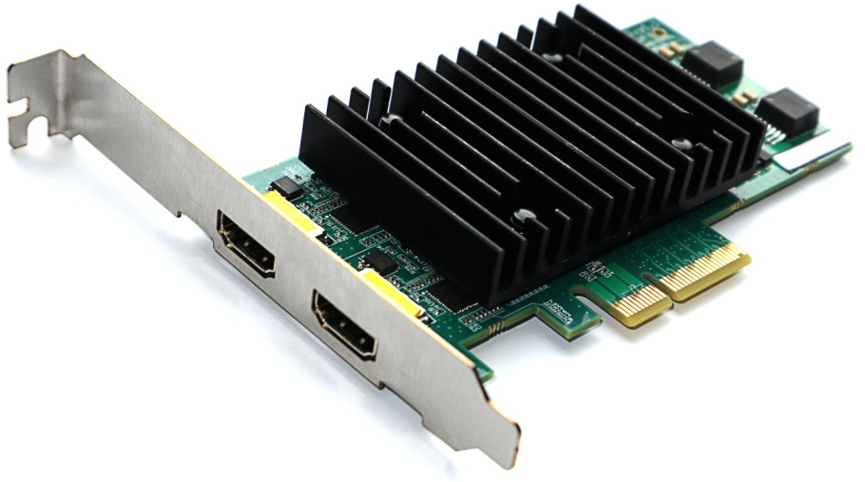
Channel-in-a-box
Forward T /
Forward Splicer
Network
Network
Notes:
We offer an All-in-one solution. What does that mean ?
Firstly that means that the unified SW supports all our HW cards.
You can easily migrate from one card to another with different interface – just replace it ! The SW remains the same, the whole TV production process remains the same! You won't have to learn new applications for it !

Slide 5


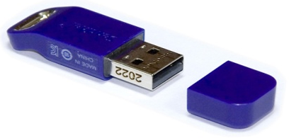
Channel-in-a-box (The Cloud)
SoftLab NetKey Holder
Virtual board
(NetKey)
Virtual board
(USB Dongle)
Input Graph (virtual input)
Video/ Audio Decoder
NR
NetKey
TS
Demux
SoftLab NetKey Holder
FDOnAir …
Mixer
Video/ Audio Encoder
TS
Muxer
SoftLab NetKey Holder
Output Graph

Slide 6
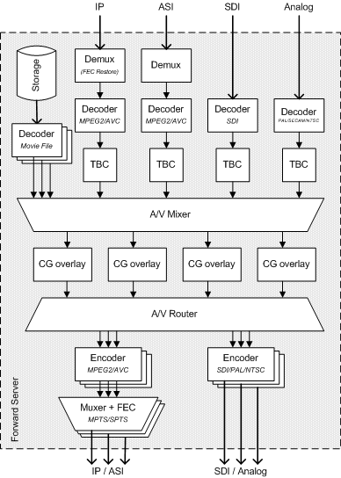
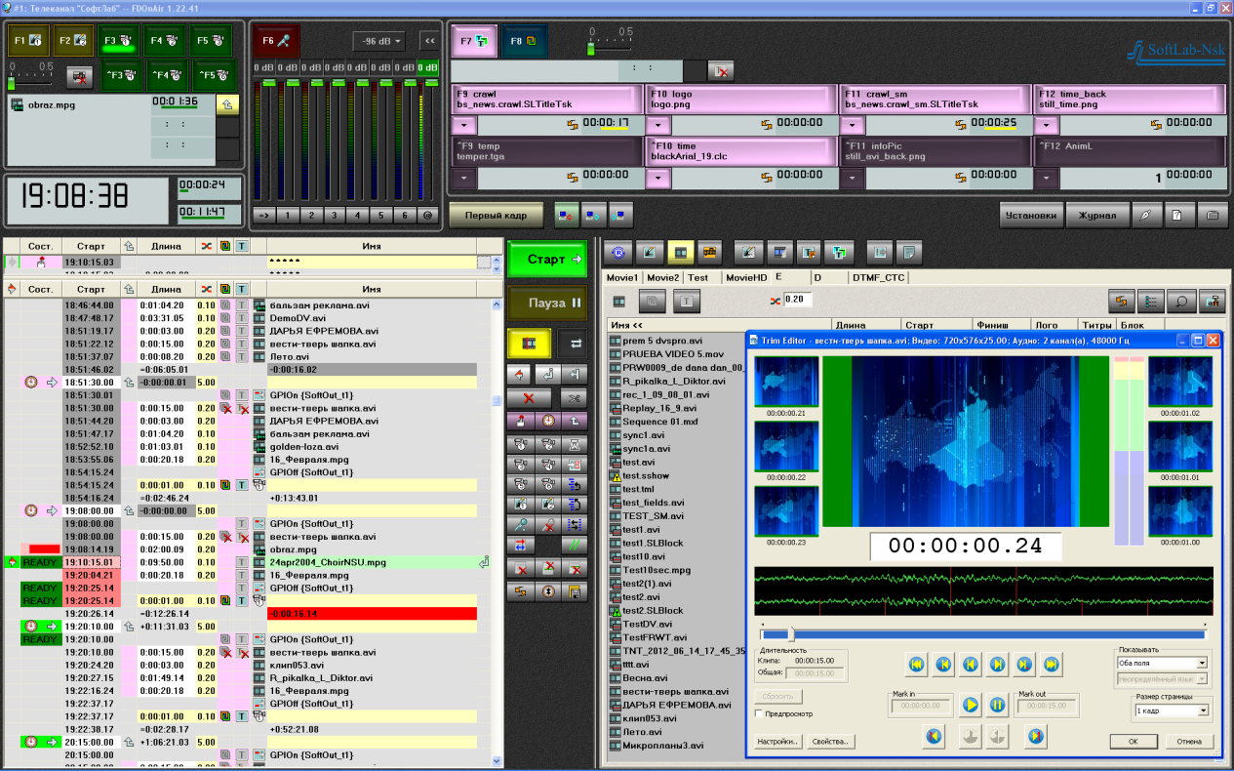
Channel-in-a-box
Notes:
Secondly, All-in-one solution means that one server can manage the whole TV channel – from mixing different input signals, overlaying CG over the feed and then to the output the finished video.
Optimized software and hardware allow to work with any TV signals without additional hardware – you get the whole TV server in one computer !

Slide 7
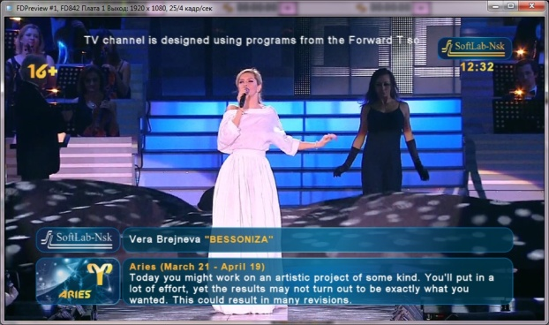
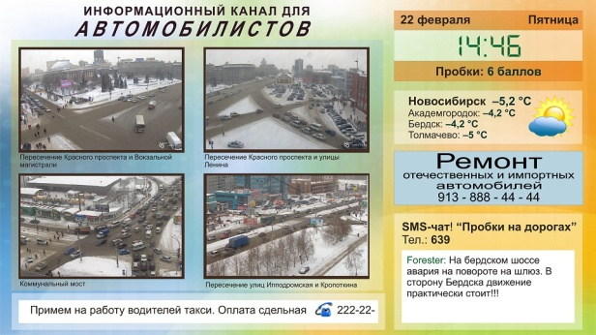
Channel-in-a-box

Slide 8
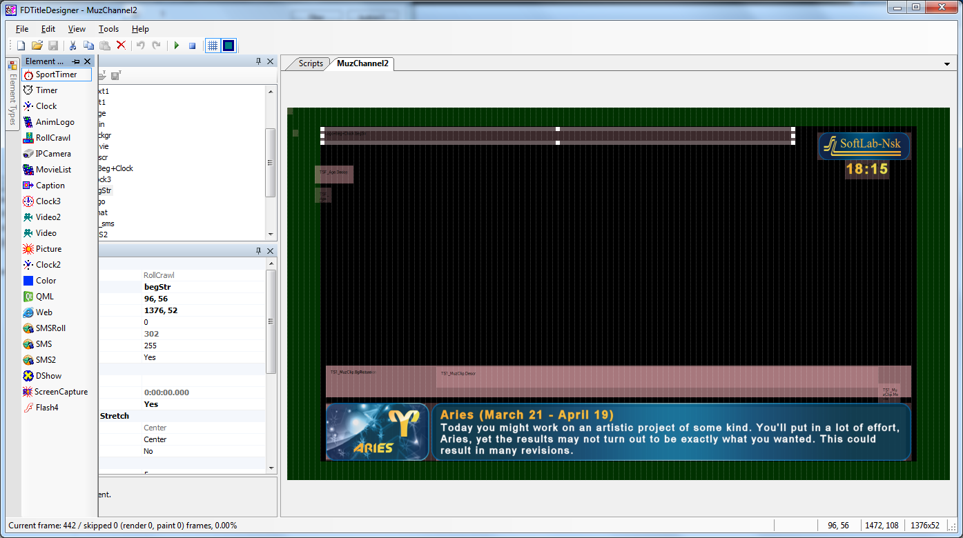
CG Template & Script Editor

Slide 9
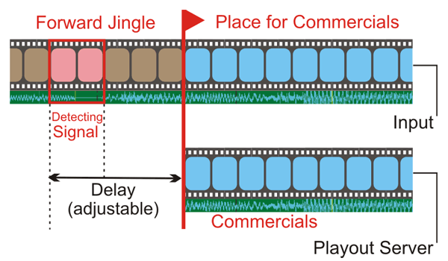
AutoDetect
Automatically ADs insertion by:
DTMF marks
Video/Audio Jingles
SCTE-35/104 marks
Upper/lower video lines
…
Notes:
ForwardT “AutoDetect” technology allows to insert advertising automatically.
It permanently monitors for special ads header and insert ads if detected.
Next part is devoted to automated ads insertion.
This a list of headers that are supported:
traditional DTMF cue tones, VITC bits VBI teletext marks, SCTE35 marks for digital TV. Also you can set your own marks that are adjustable.
For example, you can define the sample of video or audio as a header for advertisement and insert your block after it.

Slide 10
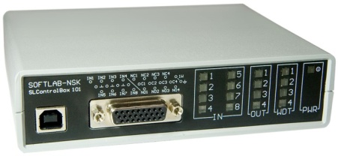
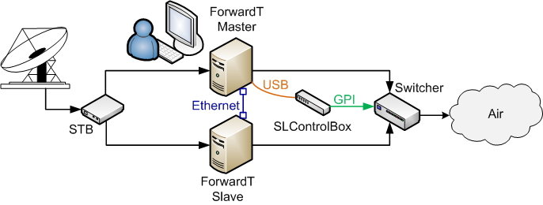
Redundancy
SLControlBox for hot mirroring
SDI input reserving
IP Input reserving
NET Key reserving
Secured format of log-file
Notes:
To improve reliability ForwardT software supports mirroring technology.
You can use SLControlBox device to operate an output switcher.

Slide 11
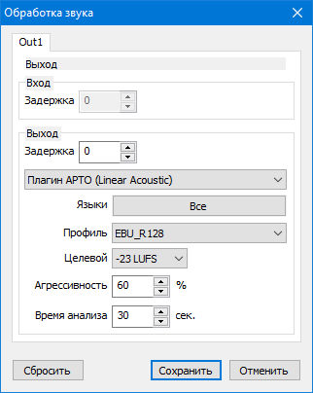
SLSoundLeveler
Audio normalization by
EBU R128
Импортозамещение плагина
APTO Linear Acoustic
Notes:
Из новых самых актуальных разработок – наш собственный плагин для нормализации звука.
Аналог плагина APTO Linear Acoustic, только без проблем с поддержкой и покупкой.

Slide 12
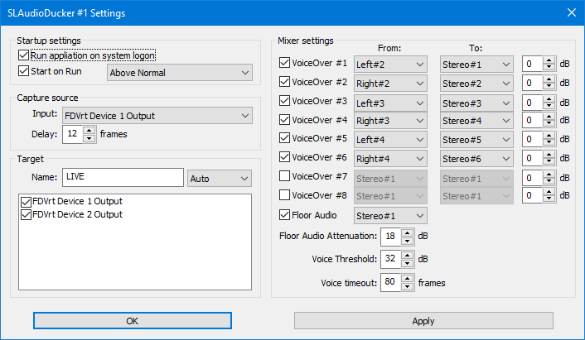
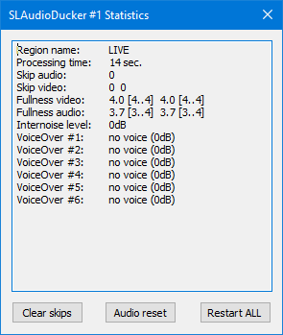

SLAudioDucker
«clever» auido mixer
Notes:
И самое свежее приложение, сделанное для работы в Катаре, «умный» звуковой микшер SLAudioDucker.
Он подмешивает общий звук FLOOR AUDIO к голосам комментаторов или переводчиков с разной громкостью. Если переводчик мочит, то floor audio подмешивается с полной громкостью, если же он что-то говорит, то громкость floor audio уменьшается до заданного порога. Поскольку при обработке звук задерживается, что вместе со звуком копируется видео.
Можно отключать обработку floor audio и просто микшировать моно или стерео каналы со входа на выход. До восьми линий микширования, каждый со своей громкостью. Например, из входа 5.1 собрать стерео выход.
В процессе работы видна статистика заполненности выходных фифо, из которой можно четко понять, успевает программа перекладывать данные со схода на выход или нет.

Slide 13
Проект для ОТР
Врезка локального контента в 85 точках
Надежная доставка видео по IP (SRT)
Автоматизированное управление из центра
Мониторинг всех потоков и состояния

Slide 14

Проект для ОТР
Forward Switcher
SDI
SDI
SDI
SRT
VPN
SRT
SRT
Наземная сеть №2
Федеральный сигнал
Наземная сеть №1
Региональная телекомпания

Slide 15
Solutions for MPTS/SPTS
Splicing – Digital Program Insertion into transport streams (without transcoding) by SCTE-35 marks
Coding/Decoding from/to SDI
Remuxing with EPG insertion
Network
Forward Splicer
Network

Slide 16
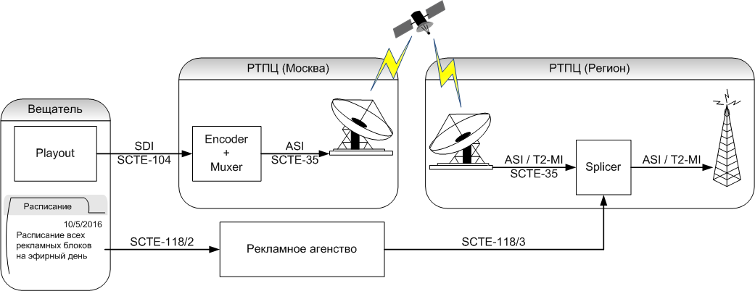
Forward Splicer
Forward Splicer

Slide 17
Forward Splicer
Local file insertion
Local live insertion
Notifications from Ministry of Emergency Situations
Virtual PC
MPTS
SPTS
Splicer
MPTS
SPTS
Local storage
with movies
FTP/HTTP
Server with
SCTE 118-3

Slide 18
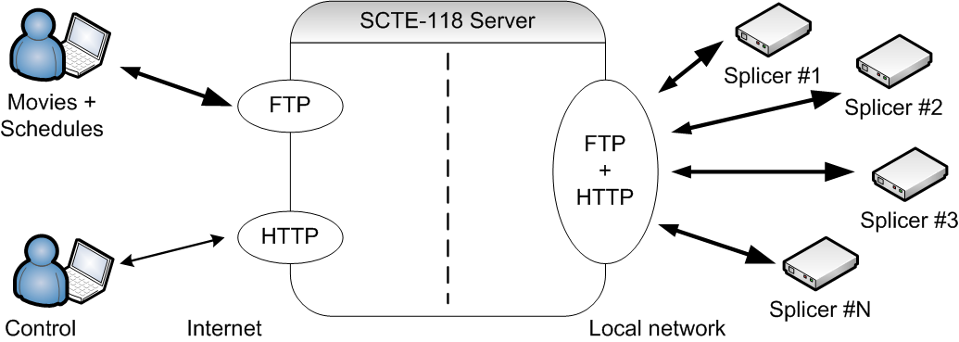
Forward Splicer

Slide 19
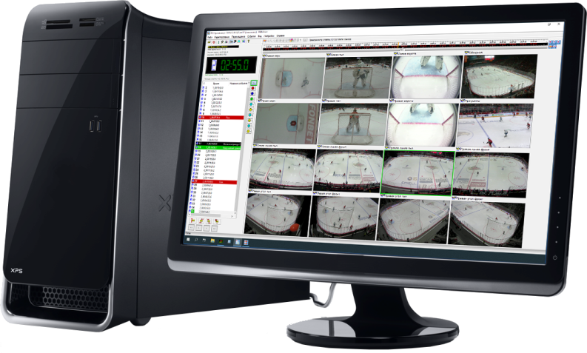
Solutions for Sport & Show
Interactive sport graphics
Multichannel recording
Slow-motion instant replay
Video Goal for referee

Slide 20
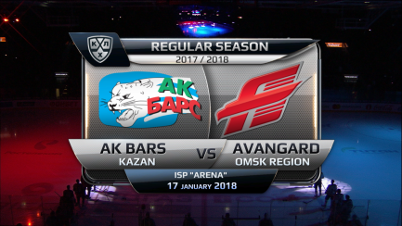
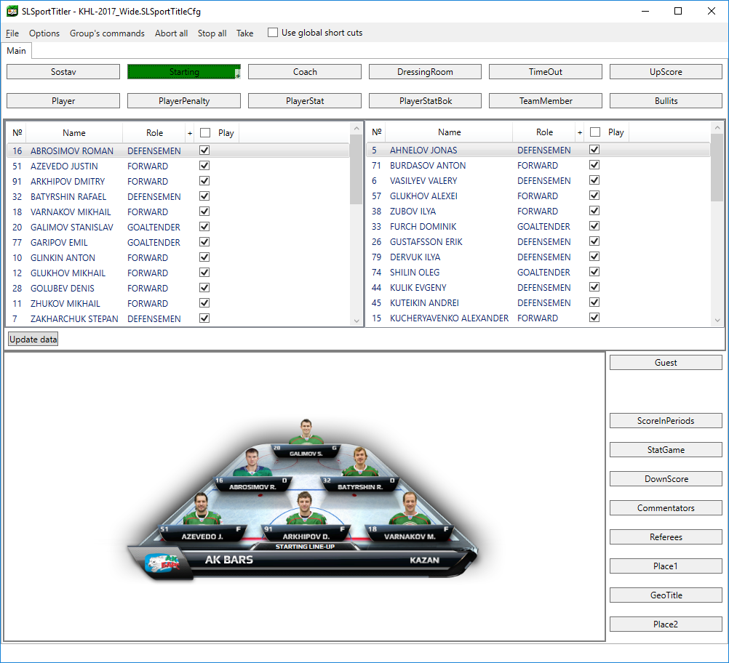
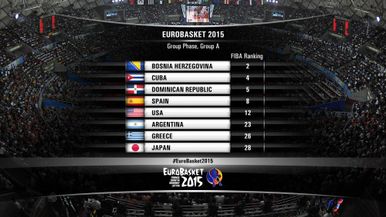
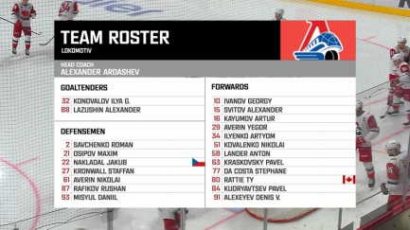
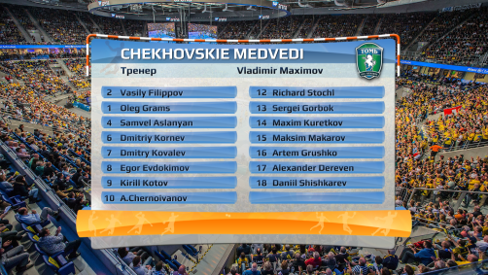
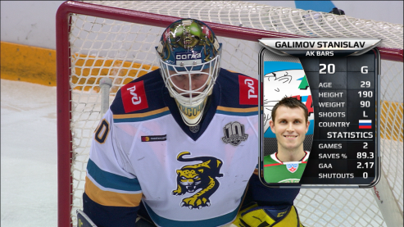
Sport Graphics

Slide 21
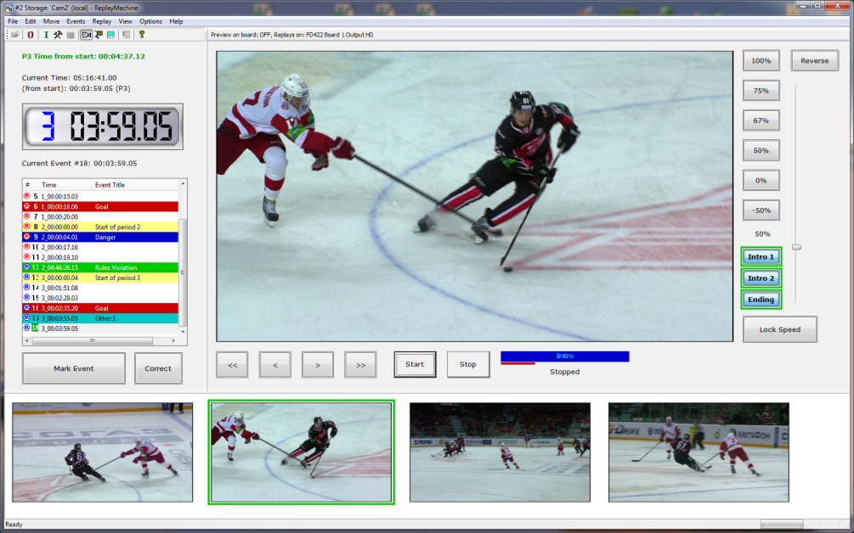
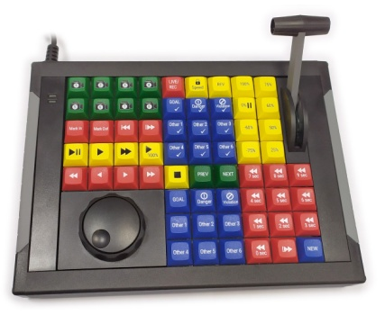
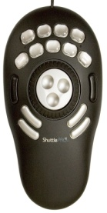
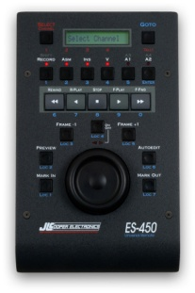
Solutions for Sport & Show
Multichannel recording
Slow-motion replay
Super-slow motion camera support

Slide 22

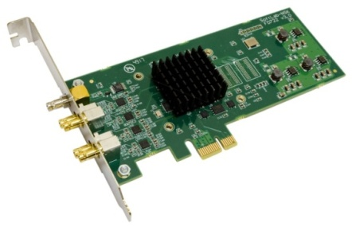

Recording & Slow-motion Replay
Recorded channels:
  from 2 up to 32
Signal types:
  analog (CVBS / YUV / RGB)
  SDI (SD/HD/3G)
  HDMI
Formats
  SD
  HD/3G
  UHD

Slide 23
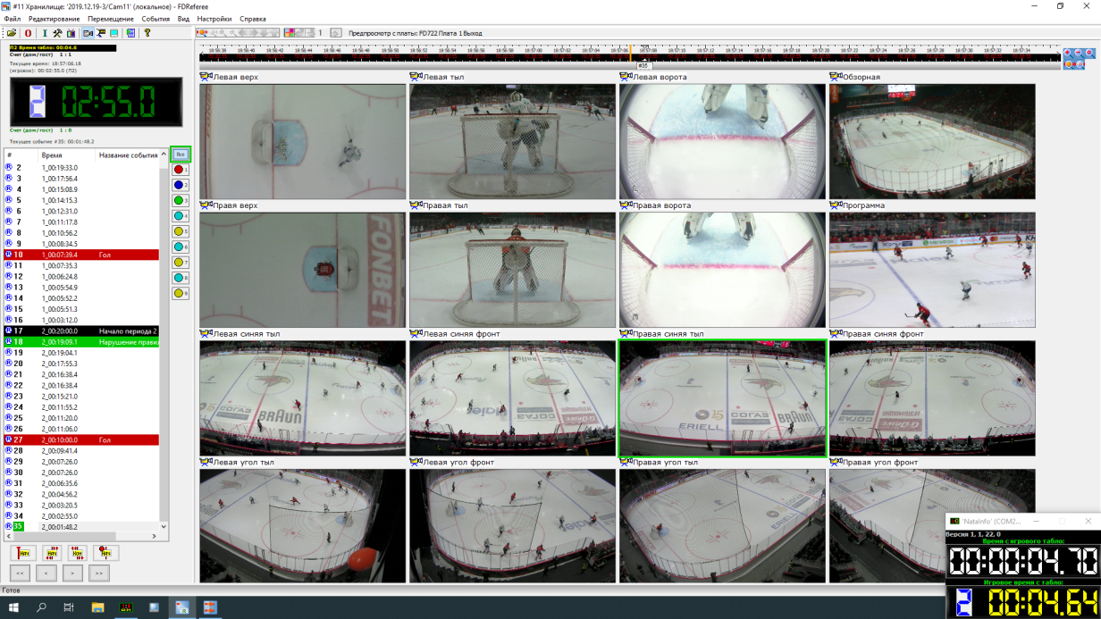



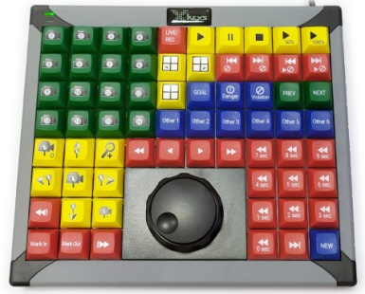


Video Referee
Score board integration

Slide 24
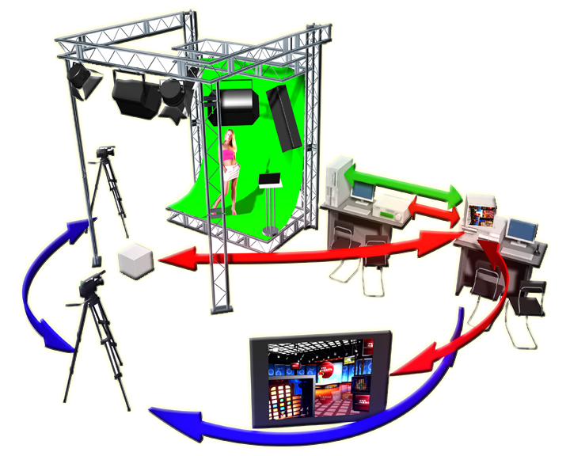

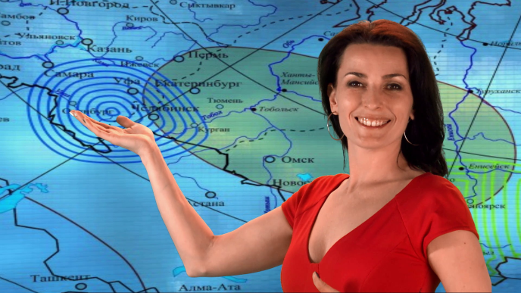
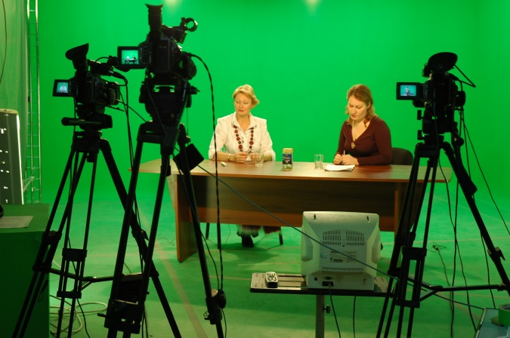
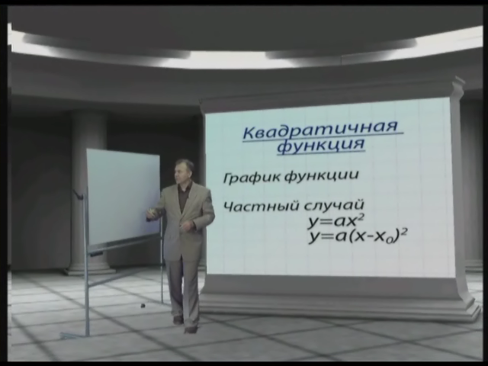
Live TV production
Notes:
… интерактивным производством
Еще в 2002 году наша виртуальная студия была отмечена международной наградой.

Slide 25
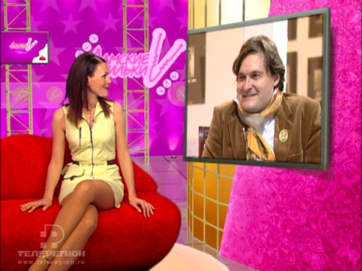
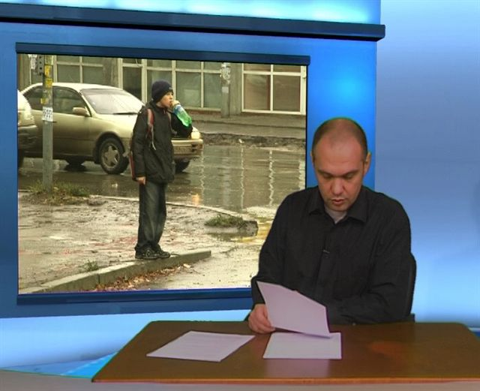
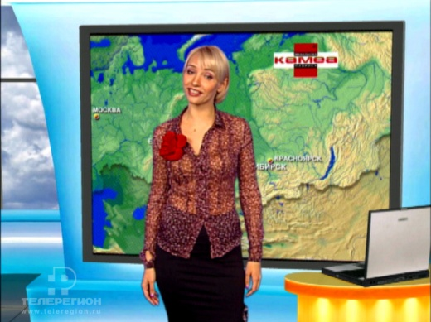
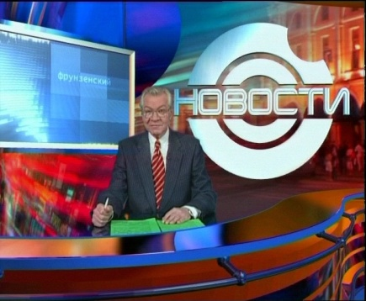
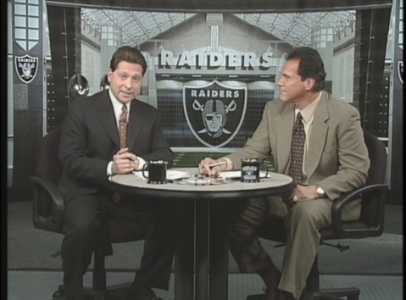
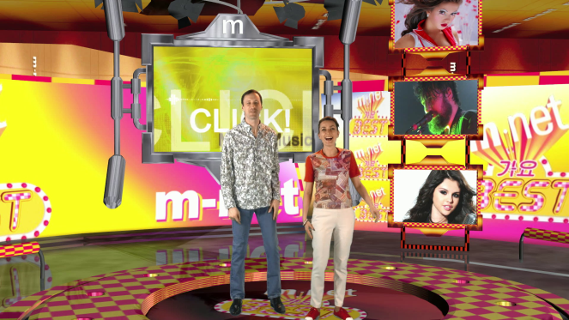
Live TV production
Notes:
Вот примеры от наших клиентов – Новосибирских (сверху), российских и зарубежных.

Slide 26
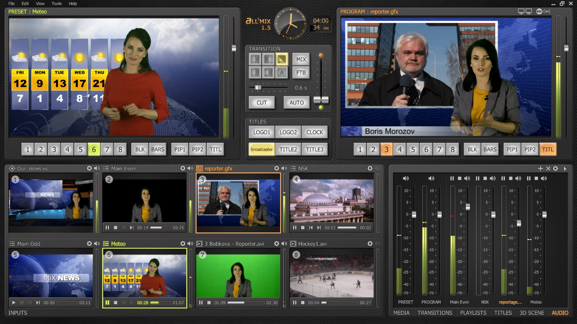
Live TV production

Slide 27
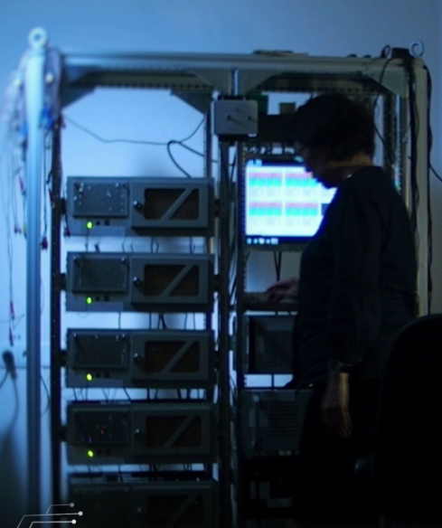
Solution Robustness
Own hardware + firmware + software
Hardware robustness:
100% product testing on our own test site
>5000 boards were produced and sold
Software robustness:
Data buffering
Separation into processes

Slide 28
Full life cycle
Idea
Implementation
Production
Promotion
Sales
Technical Support
All from SoftLab-NSK
Notes:
С точки зрения маркетинговой деятельности наша компания является центром формирования прибыли – мы контролируем весь жизненный цикл наших продуктов – от идеи до послепродажного сопровождения.

Slide 29
>30 years
on TV market

